Slide 1

PRECIS WRITING

Slide 2
Vocabulary of the Day:
Mercurial: liable to change moods suddenly
Altercation: a heated dispute or quarrel.
Bellicose: quarrelsome, eager to fight
Cabal: 1. a scheme or conspiracy. 2. A small group joined in a secret plot.
Contentious: 1. quarrelsome, competitive, quick to fight. 2. Controversial, causing contention.

Slide 3
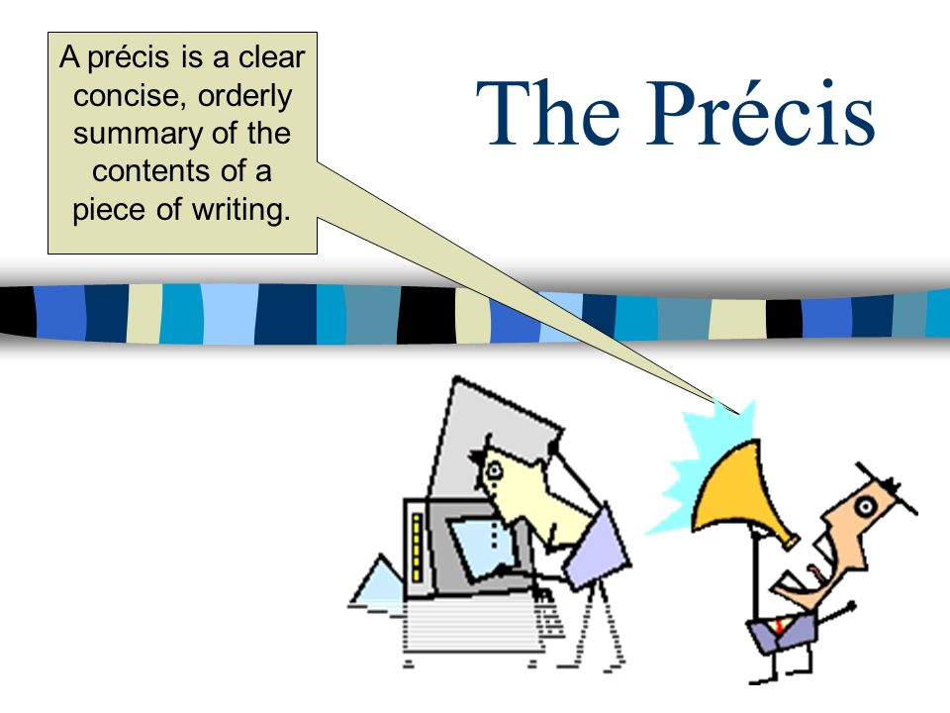
Notes:
Précis is a brief, original summary of the important ideas given in a long selection. Its aim is to give general effect created by the original selection.

Slide 4
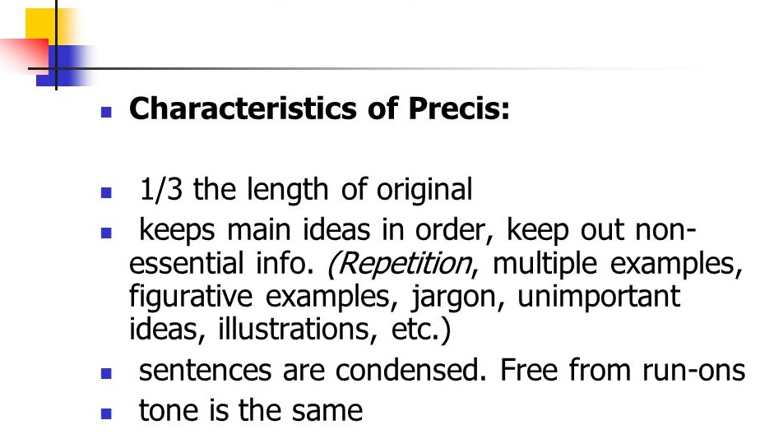

Slide 5
Question 1
The Chambers Everyday Dictionary describes précis as _______
a) a summary b) a presentation c) a story d) an incident

Slide 6
Question 1
The Chambers Everyday Dictionary describes précis as _______
a) a summary b) a presentation c) a story d) an incident

Slide 7
Question 2
The term précis in English is derived from
A. the Italian language
B. the French language
C. the German language
D. none

Slide 8
Question 2
The term précis in English is derived from
A. the Italian language
B. the French language
C. the German language
D. none

Slide 9
Question 3
How much long a précis must be?
a) One-third of original passage b) Two-third of original passage c) Same as of original passage d) One-fifth of original passage

Slide 10
Question 3
How much long a précis must be?
a) One-third of original passage b) Two-third of original passage c) Same as of original passage d) One-fifth of original passage

Slide 11
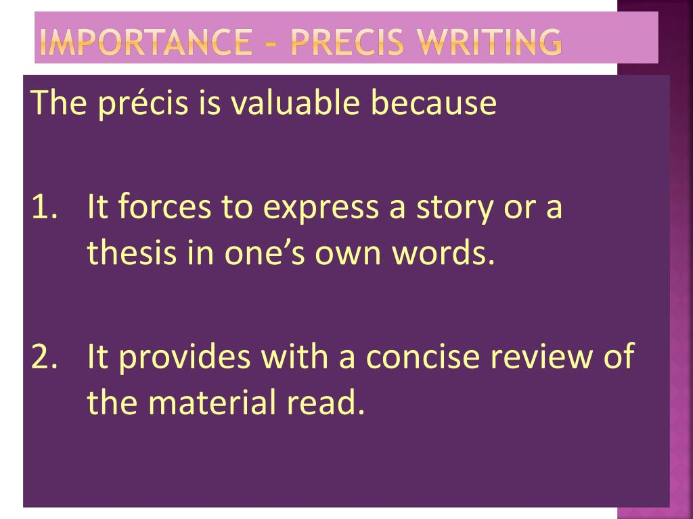

Slide 12
Question 4
Précis writing is the art of presenting certain information in condensed form.
a) True b) False

Slide 13
Question 4
Précis writing is the art of presenting certain information in condensed form.
a) True b) False

Slide 14
Question 5
A précis saves time.
a) True b) False

Slide 15
Question 5
A précis saves time.
a) True b) False

Slide 16


Slide 17
Question 6
Which one is not a quality of a good précis?
a) Completeness b) Clarity
c) Repetition
d) Unbiased

Slide 18
Question 6
Which one is not a quality of a good précis?
a) Completeness b) Clarity
c) Repetition
d) Unbiased

Slide 19
Question 7
Which of the following is not a requirement of précis writing?
A. suggestive title
B. add nothing
C. correct nothing
D decorative detail

Slide 20
Question 7
Which of the following is not a requirement of précis writing?
A. suggestive title
B. add nothing
C. correct nothing
D decorative detail

Slide 21
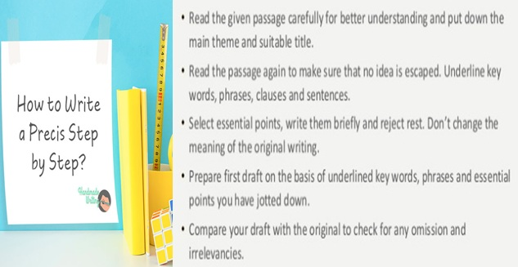

Slide 22
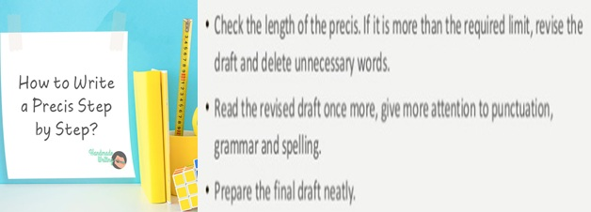

Slide 23
Question 8
For a good précis, it is important that one should have _____ it thoroughly.
Understood
Written
Read
Copy

Slide 24
Question 8
For a good précis, it is important that one should have _____ it thoroughly.
Understood
Written
Read
Copy

Slide 25
Question 9
A précis must always have a ______
a) subtitle b) title c) story d) incident

Slide 26
Question 9
A précis must always have a ______
a) subtitle b) title c) story d) incident

Slide 27
Question 10
What is a rule of précis writing?
Use minor details and comparisons
Avoid all irrelevant information/ points
Use direct speech

Slide 28
Question 10
What is a rule of précis writing?
Use minor details and comparisons
Avoid all irrelevant information/ points
Use direct speech

Slide 29
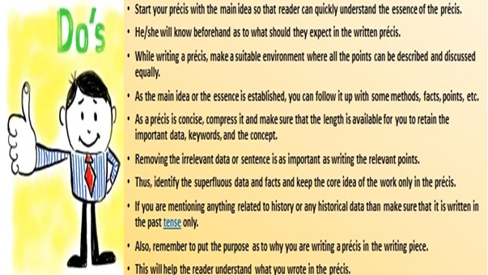

Slide 30
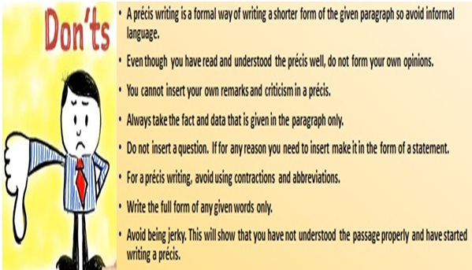

Slide 31
Question 11
Which of the following points should be avoided while writing a précis?
Full forms
Abbreviations
Historical facts
None of the above

Slide 32
Question 11
Which of the following points should be avoided while writing a précis?
Full forms
Abbreviations
Historical facts
None of the above

Slide 33
Question 12
What kind of writing is a précis writing?
Formal
Informal
Both
None

Slide 34
Question 12
What kind of writing is a précis writing?
Formal
Informal
Both
None

Slide 35
Question 13
Which words are not suitable in a précis?
Suggested, advised, questioned
required, consultant the doctor
requested, honoured, awarded
plz, coz, bt

Slide 36
Question 13
Which words are not suitable in a précis?
Suggested, advised, questioned
required, consultant the doctor
requested, honoured, awarded
plz, coz, bt

Slide 37
Question 14
Which person should be used in précis writing?
A. first person
B. second person
C. third person
D. all

Slide 38
Question 14
Which person should be used in précis writing?
A. first person
B. second person
C. third person
D. all

Slide 39
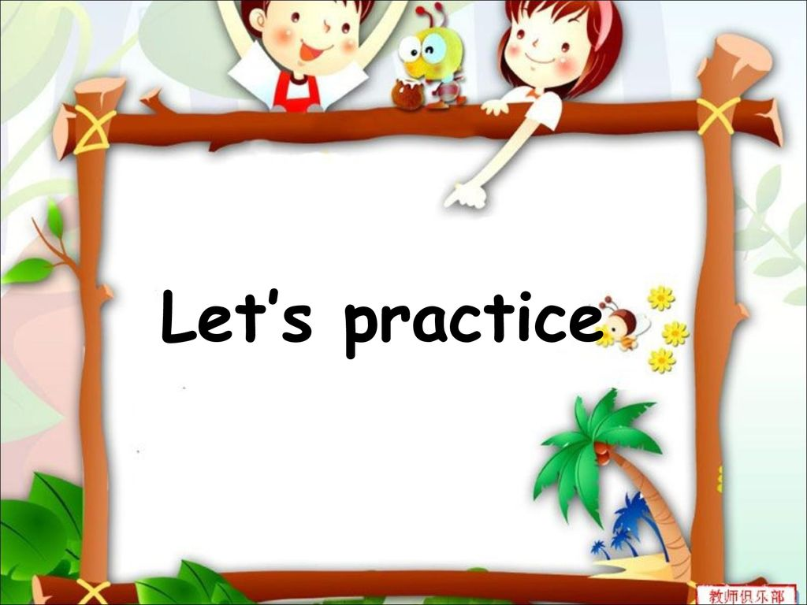

Slide 40
Question 1
Rewrite the following passage precisely into 1/3rd of its size:
One of our most difficult problems is what we call discipline and it is really very complex. You see, society feels that it must control or discipline the citizen, shape his mind according to certain religious, social, moral and economic patterns. Now, is discipline necessary at all? Please listen carefully. Don’t immediately say YES or NO. Most of us feel, especially while we are young, that there should be no discipline, that we should be allowed to do whatever we like and we think that is freedom. But merely to say that we should be free and so on has very little meaning without understanding the whole problem of discipline. The keen athlete is disciplining himself the whole time, isn't he? His joy in playing games and the very necessity to keep fit makes him go to bed early, refrain from smoking, eat the right food and generally observe the rules of good health. His discipline and punctuality is not an imposition but a natural outcome of his enjoyment of athletics.

Slide 41
ANSWER 1
Final Précis
Discipline-A way of life
Though discipline seems to be a problem, it is necessary for all. Discipline shapes our mind and regulates our habits. Some want to be free and think that it is not necessary. Discipline and punctuality give enjoyment to athletes.

Slide 42
Practice 2
Rewrite the following passage precisely into 1/3rd of its size:Soapy was homeless and usually in the pleasant summer nights, he slept on a bench in a park. However, as the nights got colder with approaching winter, he decided to move to his regular hangout during winter. There were several charitable places for the homeless in the New York City where Soapy could sleep during the frosty winter. But these establishments had numerous strict regulations and the authorities were highly inquisitive of the personal life of its inmates. So Soapy chose the prison at Blackwell’s on the island as his winter haunt. It was easy to get entry into his winter resort because all Soapy had to do is break some trivial law and he was inside with no questions asked. His plan was to go to an expensive restaurant have some exorbitantly priced dishes. When he could not pay the bill, the officials would escort him straight to his trusted winter abode. Having smartened himself up with a clean shave and a wearing a coat hand out to him long back by a philanthropist, he stealthily entered a restaurant hoping that none of the waiters would notice his tattered trousers and shoes. He decided to order a mallard duck with a bottle of White Burgundy and other luxuries. Regrettably for Soapy, as soon as he got into a grand restaurant, the chief waiter noted his ratty trousers and drove him out of the restaurant.

Slide 43
ANSWER2
Final Précis
Homeless Soapy
Soapy, a homeless man, wanted a shelter for winters but not one of those charitable homes where his personal life would be scrutinized. He chose the prison on Blackwell’s island as his home. He planned to break some law and land up in jail. He smartened himself up and went to an expensive restaurant where, showing his inability to pay, he would be imprisoned. The chief waiter noted his ratty trousers and turned him out.

Slide 44
Practice 3
Rewrite the following passage precisely into 1/3rd of its size:For centuries, people have been playing kicking games with a ball. The game of soccer developed from some of these early games. The English probably gave soccer its name and its first set of rules. In European countries, soccer is called football or association football. Some people believe that the name “soccer” came from “assoc.,” an abbreviation for the word association. Others believe that the name came from the high socks that the players wear. Organized soccer games began in 1863. In soccer, two teams of eleven players try to kick or head the ball into their opponents’ goal. The goalie, who tries to keep the ball out of the goal, is the only player on the field who is allowed to touch the ball with his or her hands. The other players must use their feet, heads, and bodies to control the ball. Every four years, soccer teams around the world compete for the World Cup. The World Cup competition started in 1930. Brazil is the home of many great soccer players, including the most famous player of all, Pelé. With his fast footwork, dazzling speed, and great scoring ability, Pelé played for many years in Brazil and then later in New York. During his 22 years in soccer, he scored 1,281 goals and held every major record for the sport. People in more than 140 countries around the world play soccer. It is the national sport of most European and Latin American countries. Soccer is definitely the world’s most popular sport!

Slide 45
ANSWER3
Final Précis
Origin of Soccer The British devised football’s rules. The name ‘Soccer’ is possibly related to players’ high socks or from ‘Association’. Born in 1863, football is played with two rival 11-player teams who try to push the ball through the opposite goal post outflanking the goalkeeper. Except him, no one can touch the ball by hand. The World Cup is staged once in four years. The Brazilian football wizard Pele bewitched football lovers with his superb skill. As the national game in Europe and Latin America, football, played in 140 countries, is world’s most popular game.

Slide 46
Practice 4
Rewrite the following passage precisely into 1/3rd of its size:
If we look back at India’s long history, we find that our forefathers made wonderful progress whenever they looked out on the world with clear and fearless eyes and kept the windows of their minds open to give and receive. And, in later periods, when they grew narrow in outlook and shrank from outside influence, India suffered a set-back, politically and culturally. What a magnificent inheritance we have, though we have abused it often enough. India has been and is a vital nation, inspite, of all the misery and suffering that she has experienced.

Slide 47
ANSWER 4
Precis
Title:- Broadmindedness-India’s Vitality’s
Ancient India was able to make tremendous progress through broad-mindedness. The narrowness in outlook that followed led to her downfall. Still, all the suffering has not been able to diminish India’s inherent vitality.

Slide 48
Practice 5
Rewrite the following passage precisely into 1/3rd of its size:
Raju welcomed the intrusion — something to relieve the loneliness of the place. The man stood gazing reverentially on his face. Raju felt amused and embarrassed. “Sit down if you like,” Raju said, to break the spell. The other accepted the suggestion with a grateful nod and went down the river steps to wash his feet and face, came up wiping himself dry with the end of a checkered yellow towel on his shoulder, and took his seat two steps below the granite slab on which Raju was sitting cross-legged as if it were a throne, beside an ancient shrine. The branches of the trees canopying the river course rustled and trembled with the agitation of birds and monkeys settling down for the night. Upstream beyond the hills the sun was setting. Raju waited for the other to say something. But he was too polite to open a conversation. Raju asked, “Where are you from?” dreading lest the other should turn around and ask the same question.
The man replied, “I’m from Mangal — “
“Where is Mangal?”

Slide 49
ANSWER5
Precis
Title:- Nelson Severely Wounded
On stepping from the boat, Nelson was shot through the right elbow and fell. Nisbet, his step-son, placed him in the bottom of the boat, and covered the wound which was gushing blood. He bound silk handkerchiefs over the torn blood vessels, thereby saving Nelson’s life, and a sling was made for the arm. The grounded boat was re-floated and went close under the battery to avoid its fire. Nelson asked to be lifted to look around.

Slide 50
